Slide 1

Type 2 Diabetes

Slide 2

Statistical question/Hypothesis
What role does BMI / Waist Circumference play in relation to Type 2 Diabetes?
Does having a family history increase the risk of developing diabetes?

Slide 3
Variables used for Analysis
Family History
Blood Glucose Levels
Age
BMI
Waist Circumference

Slide 4
What does these Variables mean ?
Family History - Yes=Someone in family is/was Diabetic, No=No one in family is/was Diabetic
Insulin Levels - Blood Sugar level
Age - Age of the participant
BMI - Body mass index of the participant
Waist Circumference - Waist circumference is a better estimate of 'visceral fat'. This is the dangerous internal fat that coats your organs.

Slide 5
Outlier:
There is NO Outlier.
Data contains all types of Diabetes from birth age to 80 years old participants.
How it is Handled:
Filter only “Type 2 Diabetes” from the dataset for further analysis.
Also, this research is only for women because data contains field called “Weight Gain During Pregnancy”

Slide 6
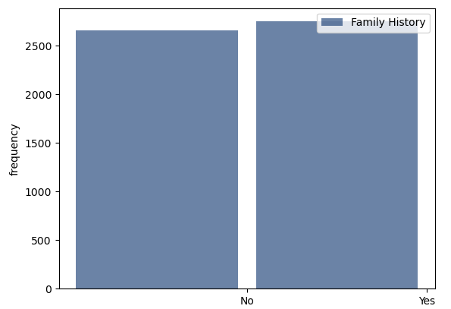
Family History
Mean = 0.5088011858439874
Mode = 1
Variance = 0.2499688553877707
Tail = []

Slide 7
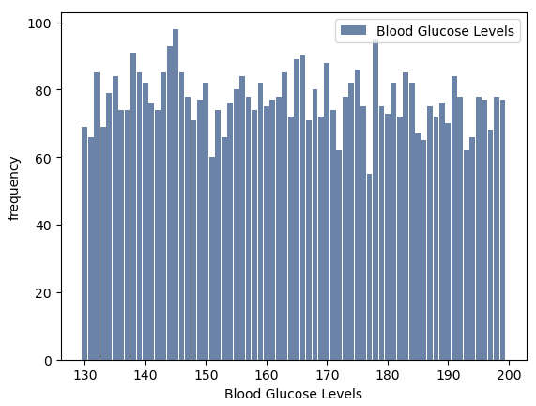
Blood Glucose Levels
Mean = 164.0841208078562
Mode = 145
Variance = 403.11857100690014
Tail = []

Slide 8
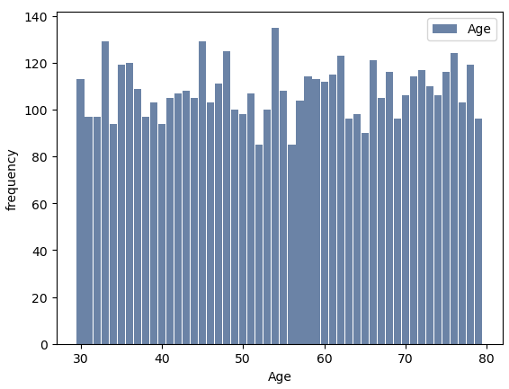
Age
Mean = 54.609783212896055
Mode = 54
Variance = 209.52931865203095
Tail = []

Slide 9
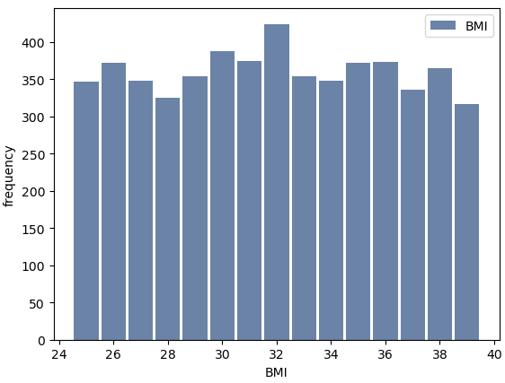
BMI
Mean = 31.969242171576802
Mode = 32
Variance = 18.07577727955555
Tail = []

Slide 10
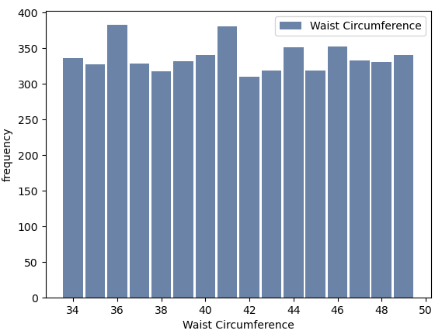
Waist Circumference
Mean = 41.475634611821384
Mode = 36
Variance = 21.297636388334787
Tail = []

Slide 11
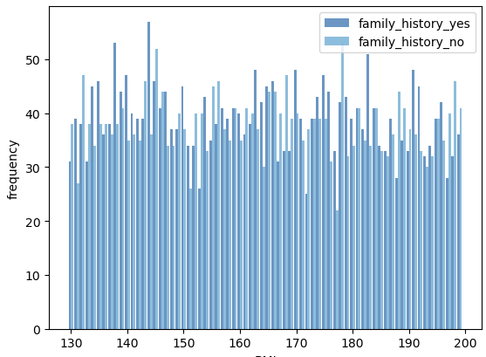
Comparing two scenarios using PMF
Comparing the impact of family history, its role was not as significant as I initially expected.

Slide 12
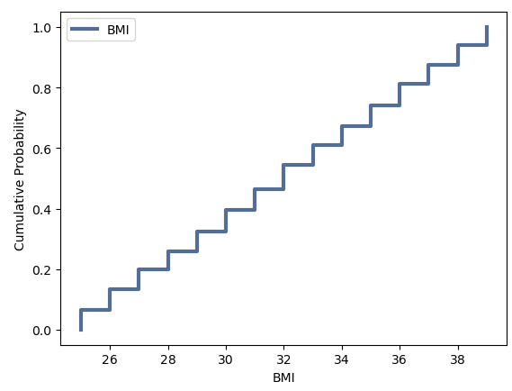
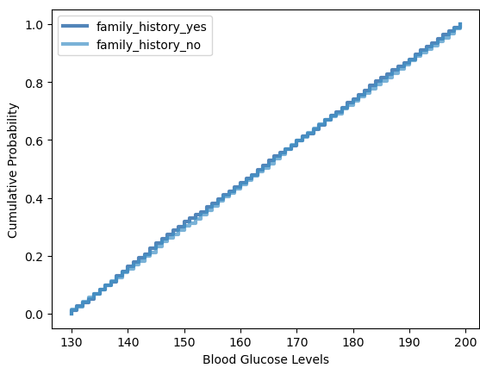
CDF (Cumulative Distribution Function)
This Graph (Left) shows the Cumulative Probability of BMI.
The CDF for the BMI field indicates that the values are evenly distributed between 25 and 40, with a BMI of 32 marking the 50th percentile.
This Graph (Right) shows the Cumulative Probability of Blood Glucose Levels for two groups (with family history and without family history).
The CDF for the Blood Glucose Levels field indicates that the values are evenly distributed between 130 to 200 with a Blood Glucose Levels of little over 160 marking the 50th percentile.

Slide 13
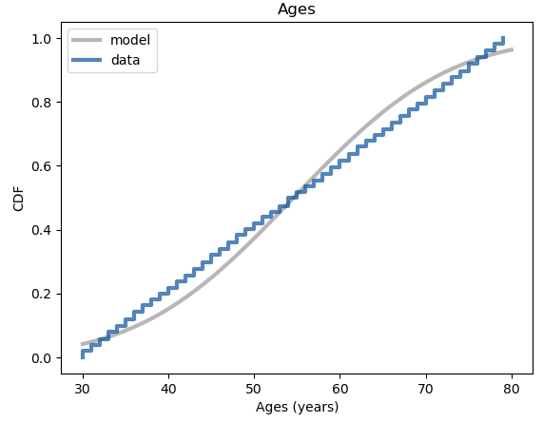
Analytical Distribution
This graph compares the Empirical CDF of participant ages with the CDF of a normal distribution having the same mean and variance.
The occurrence of Type 2 Diabetes is observed between ages 30 and 80.
The data shows only slight deviations from the normal distribution model.
Type 2 Diabetes is less frequent before age 32, more common between ages 35 and 50, decreases between 58 and 78, and then rises again after age 78.

Slide 14
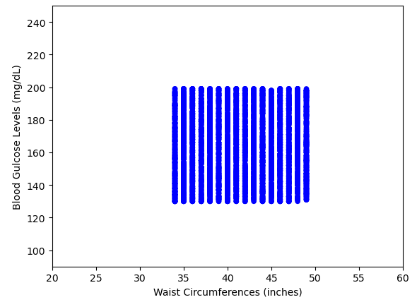
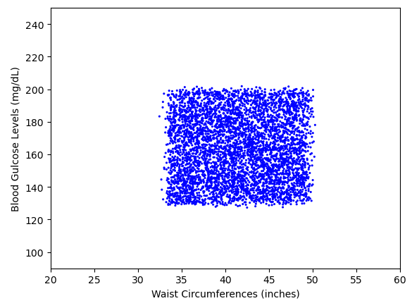
Scatter plots comparing Blood Glucose Levels and Waist Circumferences
This graph displays scatter plots illustrating the relationship between Blood Glucose Levels and Waist Circumferences.
Waist Circumference, measured in inches, appears to have values rounded to the nearest whole number in the dataset.
To enhance visualization, jitter has been applied to both Blood Glucose Levels and Waist Circumference values.

Slide 15
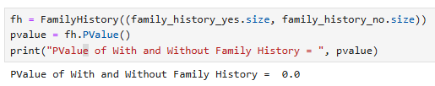
Testing Hypothesis
The p-value for the comparison between participants with and without a family history of Type 2 Diabetes is 0.0. This indicates that if Type 2 Diabetes were evenly distributed, the likelihood of observing a difference as large as 3,230 by chance is 0%.
Therefore, the impact of family history was found to be statistically insignificant.

Slide 16
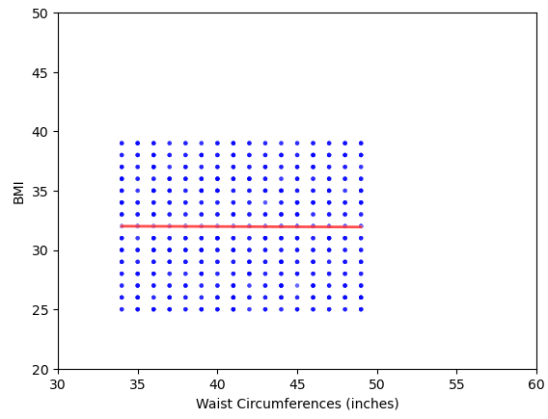
Regression analysis
This Graph shows the relationship between BMI and Waist Circumference is Linear and the fitted line fits amazingly well.

Slide 17
Reference
https://www.kaggle.com/code/ahmedashrafhelmi/diabetes
ThinkStats – Exploratory Data Analysis By Allen B. Downey

